Slide 1
Prior Art
Behin-Aein, B., Diep, V. & Datta, S., “A building block for hardware belief networks.” Sci Rep 6, 29893 (2016). https://doi.org/10.1038/srep29893
Sutton, B., Camsari, K., Behin-Aein, B. et al. Intrinsic optimization using stochastic nanomagnets. Sci Rep 7, 44370 (2017). https://doi.org/10.1038/srep44370
K. Y. Camsari, S. Salahuddin and S. Datta, "Implementing p-bits With Embedded MTJ," in IEEE Electron Device Letters, vol. 38, no. 12, pp. 1767-1770, Dec. 2017, doi: 10.1109/LED.2017.2768321.
K. Y. Camsari, S. Datta and S. Salahuddin, “Stochastic switching device with adjustable randomness ,” US10607674B2
B. Sutton, R. Faria, L. A. Ghantasala, R. Jaiswal, K. Y. Camsari and S. Datta, "Autonomous Probabilistic Coprocessing With Petaflips per Second," in IEEE Access, vol. 8, pp. 157238-157252, 2020, doi: 10.1109/ACCESS.2020.3018682.

Slide 2
Ludwig Computing Proprietary and Confidential
Neural Network Processing System with Tunable Probabilistic Elements
Parameters
1
100
Parameter P-Block
2
200
INPUTS
Neuron
P-Block
Bitwise Multiplication
Block
ADDITION
Block
OUTPUT
S
3
4
5
6
300
400
500
600
700
Figure 1

Slide 3
Ludwig Computing Proprietary and Confidential
This invention introduces a versatile data processing system within a neural network, featuring key components such as Inputs (Neurons/Activations), Neuron P-BLOCK, Parameters (Weights and Biases), Parameter P-BLOCK, Bitwise Multiplication unit, Addition unit, and Outputs.
P-BLOCKs: Probabilistic Elements
• Neuron P-BLOCK: Contains probabilistic neurons with non-linearity, generating probabilistic outputs based on activations from the previous layer.
• Parameter P-BLOCK: Incorporates mechanisms like thermal noise or other stochastic elements to introduce randomness to weights and biases.
System Workflow
1. Parameters (Weights and Biases): Stored in memory and may be processed through the Parameter P-BLOCK to add probabilistic variations or used directly.
2. Bitwise Multiplication Unit: Executes multiplication operations on input activations and parameters, integrating probabilistic elements if the P-BLOCKs are used.
3. Addition Unit: Aggregates results using methods like adder trees or capacitor-based addition introducing the final output which serves as the activation for the next neural network layer.
Flexibility
The system is designed for adaptability, allowing configurations where parameters (Weights and Biases) or activations (Neurons) may or may not go through the P-BLOCKs (Neuron P-BLOCK and Parameter P-BLOCK). This flexibility enables tailored implementations based on specific application requirements, ensuring optimal performance.

Slide 4
Ludwig Computing Proprietary and Confidential
Figure 1 Components
100. Parameters Block (Weights and Biases)
Stores and provides parameters such as weights and biases used in computation. It may be near the bitwise multiplication block (500) or embed the bitwise multiplication elements (500) within itself for in-memory processing.
200. Parameter P-BLOCK
Adds probabilistic elements to the parameters (weights and biases) retrieved from memory.
300. Inputs (Neurons/Activations)
Receives activations from the previous layer of the neural network.
400. Neuron P-BLOCK
Introduces probabilistic elements into the input activations.
500. Bitwise Multiplication
Performs bitwise multiplication operations between the processed input activations and the processed parameters.
600. Addition
Aggregates the results from the bitwise multiplication stage.
700. Outputs
Produces the final processed data, which serves as activations for the next layer of the neural network.

Slide 5
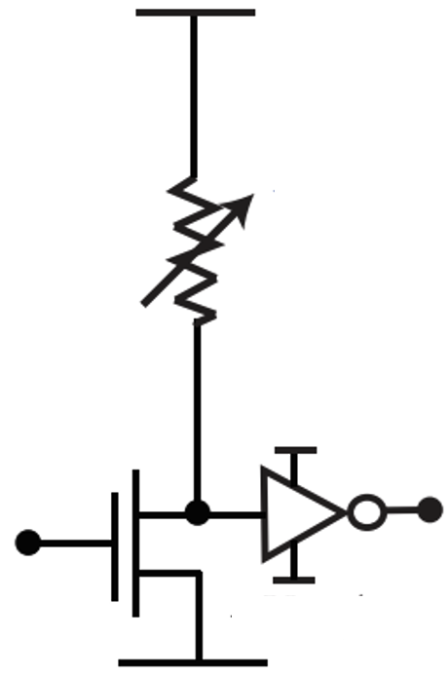
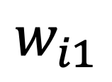
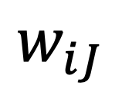
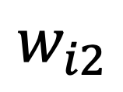
Ludwig Computing Proprietary and Confidential
200- Parameter P-Block
Figure 2
V_{op}
DAC
$$w_{i1}$$
201
Fluctuating Resistor
V₁
1
2
V₂
$$w_{i2}$$
…
V_{J}
$$w_{iJ}$$

Slide 6
Ludwig Computing Proprietary and Confidential
Figure 2: Detailed Description of Parameter P-Block (200)
Parameter P-Block:
The Parameter P-Block is a critical component within the neural network processing system, designed to introduce probabilistic elements into the parameters (weights and biases) of the neural network. This block operates by incorporating stochastic mechanisms, such as thermal noise or other random fluctuations, to modify the parameters retrieved from memory. This probabilistic variation enhances the system’s adaptability and robustness.
Components:
1. DAC (Digital-to-Analog Converter):
• Converts digital signals into analog voltages (V₁ through V_{J}) that serve as inputs to the gate of the transistor connected to the fluctuating resistor.
• Ensures precise control over the modulation process.
2. Fluctuating Resistor:
• Generates controlled random variations in resistance, introducing randomness into the parameters.
• Utilizes thermal noise or other sources of stochastic behavior to achieve this variability.
3. Vop (Output Voltage):
• Provides the energy source for the P-Block, driving the operation of the fluctuating resistor and other components.
4. Wij (Output Voltages):
• The resultant output voltages in the form of probabilistic 1’s and 0’s.
• These probabilistic outputs act as the inputs for the pertinent next stage of the neural network processing system.
Workflow:
• Parameters (weights and biases) stored in memory are first processed through the DAC to obtain precise control signals (V₁ through V_{J}).
• These signals modulate the gate of the transistor connected to the fluctuating resistor, introducing the probabilistic variations.
• The modified parameters, represented by the output voltages (W_{ij}) in the form of probabilistic 1’s and 0’s, are then used in further computational stages of the neural network, ensuring that the parameters carry the desired level of randomness.

Slide 7
Ludwig Computing Proprietary and Confidential
Figure 2: Detailed Description of Parameter P-Block (200)
Continued…
Workflow:
• Parameters (weights and biases) stored in memory are first processed through the DAC to obtain precise control signals (V₁ through V_{J}).
• These signals modulate the gate of the transistor connected to the fluctuating resistor, introducing the probabilistic variations.
• The modified parameters, represented by the output voltages (W_{ij}) in the form of probabilistic 1’s and 0’s, are then used in further computational stages of the neural network, ensuring that the parameters carry the desired level of randomness.

Slide 8
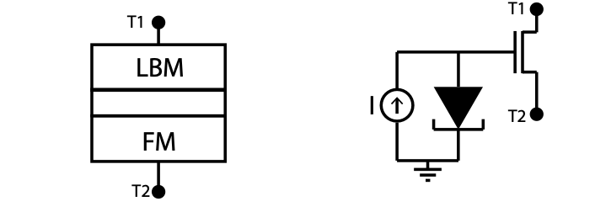
Ludwig Computing Proprietary and Confidential
400- Activation P-Block
Figure 3
V_{op}
DAC
Fluctuating Resistor
V₁
a₁
401
402
Stochastic Magnetic Tunnel Junction
Quantum Tunneling
Diode
V₂
a₂
3
4
…
V_{J}
a_{J}

Slide 9
Ludwig Computing Proprietary and Confidential
Figure 3: Detailed Description of Activation P-Block
Activation P-Block:
The Activation P-Block is an essential component within the neural network processing system, designed to introduce probabilistic elements into the input activations. This block operates by incorporating stochastic mechanisms, such as thermal noise or other random fluctuations, to modify the activations received from the previous layer. This probabilistic variation enhances the system’s adaptability and robustness.
Components:
1. DAC (Digital-to-Analog Converter):
• Converts digital signals into analog voltages (V1 through VJ) that serve as inputs to the gate of the transistor connected to the fluctuating resistor.
• Ensures precise control over the modulation process.
2. Fluctuating Resistor:
• Generates controlled random variations in resistance, introducing randomness into the activations.
• Can be implemented using:
• 401 - A stochastic magnetic tunnel junction (s-MTJ), as described in the p-bit patent (US10607674B2).
• 402 - A quantum tunneling diode, which leverages quantum mechanical effects to achieve stochastic behavior.
3. Transistor and Inverter (P-bit Formation):
• The first transistor, the fluctuating resistor, and the subsequent inverter together form a p-bit.
• This p-bit generates probabilistic outputs, enhancing the neural network’s capability to handle uncertainty and variability in the data.
4. Vop (Output Voltage):
• Provides the energy source for the Activation P-Block, driving the operation of the fluctuating resistor and other components.
5. a_{i} (Probabilistic Activations):
• The resultant output activations in the form of probabilistic values.
• These probabilistic activations act as the inputs for the pertinent next stage of the neural network processing system.

Slide 10
Ludwig Computing Proprietary and Confidential
Figure 3: Detailed Description of Activation P-Block
Continued…
Workflow:
• Activations received from the previous neural network layer are first processed through the DAC to obtain precise control signals (V1 through VJ).
• These signals modulate the gate of the transistor connected to the fluctuating resistor, forming a p-bit and introducing probabilistic variations.
• The modified activations, represented by the output values (ai) in the form of probabilistic activations, are then used in further computational stages of the neural network, ensuring that the activations carry the desired level of randomness.
Acknowledgment of Prior Art:
• The p-bit technology used in the Activation P-Block is based on the invention described in US10607674B2. This invention leverages the p-bit to introduce probabilistic behavior in neural network activations, but does not claim to reinvent the p-bit itself. Instead, it focuses on how the p-bit is integrated into the larger neural network processing system to achieve enhanced adaptability and robustness.

Slide 11
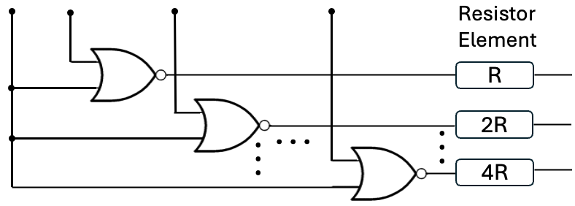
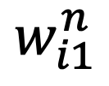
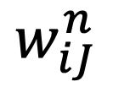
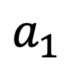
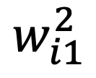
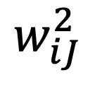
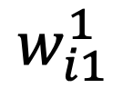
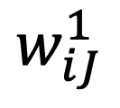
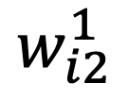
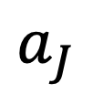
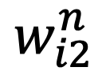
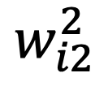
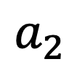
Ludwig Computing Proprietary and Confidential
500- Bitwise multiplication block – Embodiment 1
2
Figure 4a
$$a_{1}$$
$$w_{i1}^{1}$$
$$w_{i1}^{2}$$
$$w_{i1}^{n}$$
LG
1
501
LG
2
LG
n
$$a_{2}$$
$$w_{i2}^{1}$$
$$w_{i2}^{2}$$
$$w_{i2}^{n}$$
4
LG
1
5
LG
2
LG
n
. . .
$$a_{J}$$
$$w_{iJ}^{1}$$
$$w_{iJ}^{2}$$
$$w_{iJ}^{n}$$
LG
1
LG
2
LG
n

Slide 12
Ludwig Computing Proprietary and Confidential
Figure 4a: Detailed Description of Bitwise Multiplication Block – Embodiment 1
Bitwise Multiplication Block (Embodiment 1):
The Bitwise Multiplication Block is a crucial component in the neural network processing system, responsible for performing bitwise multiplication operations between processed input activations and processed parameters. This block integrates the probabilistic elements introduced by the P-BLOCKs, ensuring that the calculations account for the desired level of randomness.
Components:
1. LG (Logic Gates):
• Utilized for bitwise multiplication operations.
• Ensure efficient and accurate processing of binary inputs and parameters.
2. Bitwise Multiplication Elements:
• Arranged in a structured layout to handle multiple inputs and outputs simultaneously.
• Designed to support high-speed operations necessary for real-time neural network processing.
3. Input Activations (a1 through aJ):
• Received from the previous layer and processed through the Neuron P-BLOCK.
• Introduce probabilistic variations based on the system configuration.
4. Parameters (wi1 through w1j):
• Retrieved from memory and processed through the Parameter P-BLOCK.
• Incorporate probabilistic variations to enhance adaptability and robustness.
• The superscripts of parameters “wij” represent the digital bits comprising the w_{ij} number in binary form.
5. Outputs 1-n:
• Result from the bitwise multiplication of input activations and parameters.
• Serve as the inputs for the subsequent addition block, continuing the neural network processing pipeline.

Slide 13
Ludwig Computing Proprietary and Confidential
Figure 4a: Detailed Description of Bitwise Multiplication Block – Embodiment 1 Continued
Workflow:
• The Bitwise Multiplication Block receives processed input activations (ai) and parameters (wij) from their respective P-BLOCKs.
• Logic gates (LG) within the block perform bitwise multiplication operations between these inputs, ensuring that the probabilistic elements are integrated into the calculations.
• The resultant outputs 1-n are produced, incorporating the desired level of randomness and variability introduced by the P-BLOCKs.
• These outputs 1-n are then forwarded to the addition block for further aggregation and processing, forming the activations for the next layer of the neural network.
Embodiment 1 Layout:
• The layout of Embodiment 1 showcases a structured arrangement of logic gates (LG) and bitwise multiplication elements, designed to handle a range of input activations and parameters.
• The block efficiently manages multiple inputs and outputs, facilitating high-speed operations and ensuring optimal performance for real-time neural network processing.
Acknowledgment of Prior Art:
• The Bitwise Multiplication Block utilizes existing technologies for bitwise operations but integrates them in a novel way to handle probabilistic elements introduced by the P-BLOCKs. This ensures that the neural network can effectively manage uncertainty and variability in the data, enhancing its overall adaptability and robustness.

Slide 14
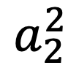
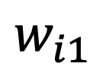
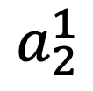
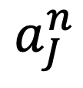
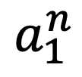
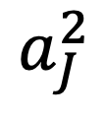
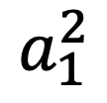
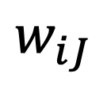
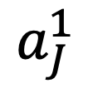
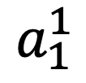
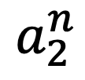
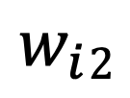
Ludwig Computing Proprietary and Confidential
500- Bitwise multiplication block – Embodiment 2
4
Figure 4b
$$w_{i1}$$
$$a_{1}^{1}$$
$$a_{1}^{2}$$
$$a_{1}^{n}$$
LG
1
501
LG
2
LG
n
$$w_{i}2$$
$$a_{2}^{1}$$
$$a_{2}^{2}$$
$$a_{2}^{n}$$
2
LG
1
5
LG
2
LG
n
. . .
$$w_{iJ}$$
$$a_{J}^{1}$$
$$a_{J}^{2}$$
$$a_{J}^{n}$$
LG
1
LG
2
LG
n

Slide 15
Ludwig Computing Proprietary and Confidential
Figure 4b: Detailed Description of Bitwise Multiplication Block – Embodiment 2
Bitwise Multiplication Block (Embodiment 2):
The Bitwise Multiplication Block is a crucial component in the neural network processing system, responsible for performing bitwise multiplication operations between processed input activations and processed parameters. This block integrates the probabilistic elements introduced by the P-BLOCKs, ensuring that the calculations account for the desired level of randomness.
Components:
1. LG (Logic Gates):
• Utilized for bitwise multiplication operations.
• Ensure efficient and accurate processing of binary inputs and parameters.
2. Bitwise Multiplication Elements:
• Arranged in a structured layout to handle multiple inputs and outputs simultaneously.
• Designed to support high-speed operations necessary for real-time neural network processing.
3. Input Activations (a1 through aJ):
• Received from the previous layer and processed through the Neuron P-BLOCK.
• Introduce probabilistic variations based on the system configuration.
• The superscripts of activations “a_{j}” represent the digital bits comprising the “aj” number in binary form.
4. Parameters (wi1 through w1j):
• Retrieved from memory and processed through the Parameter P-BLOCK.
• Incorporate probabilistic variations to enhance adaptability and robustness.
5. Outputs 1-n:
• Result from the bitwise multiplication of input activations and parameters.
• Serve as the inputs for the subsequent addition block, continuing the neural network processing pipeline.

Slide 16
Ludwig Computing Proprietary and Confidential
Figure 4b: Detailed Description of Bitwise Multiplication Block – Embodiment 2 Continued…
Workflow:
• The Bitwise Multiplication Block receives processed input activations (a1 through aJ) and parameters (wi1 through w1j) from their respective P-BLOCKs.
• Logic gates (LG) within the block perform bitwise multiplication operations between these inputs, ensuring that the probabilistic elements are integrated into the calculations.
• The resultant outputs 1-n are produced, incorporating the desired level of randomness and variability introduced by the P-BLOCKs.
• These outputs 1-n are then forwarded to the addition block for further aggregation and processing, forming the activations for the next layer of the neural network.
Embodiment 2 Layout:
• The layout of Embodiment 2 showcases an alternative structured arrangement of logic gates (LG) and bitwise multiplication elements, designed to handle a range of input activations and parameters.
• This embodiment provides flexibility in configuration, allowing for optimized performance based on specific application requirements.
• The block efficiently manages multiple inputs and outputs, facilitating high-speed operations and ensuring optimal performance for real-time neural network processing.
Acknowledgment of Prior Art:
• The Bitwise Multiplication Block utilizes existing technologies for bitwise operations but integrates them in a novel way to handle probabilistic elements introduced by the P-BLOCKs. This ensures that the neural network can effectively manage uncertainty and variability in the data, enhancing its overall adaptability and robustness.

Slide 17
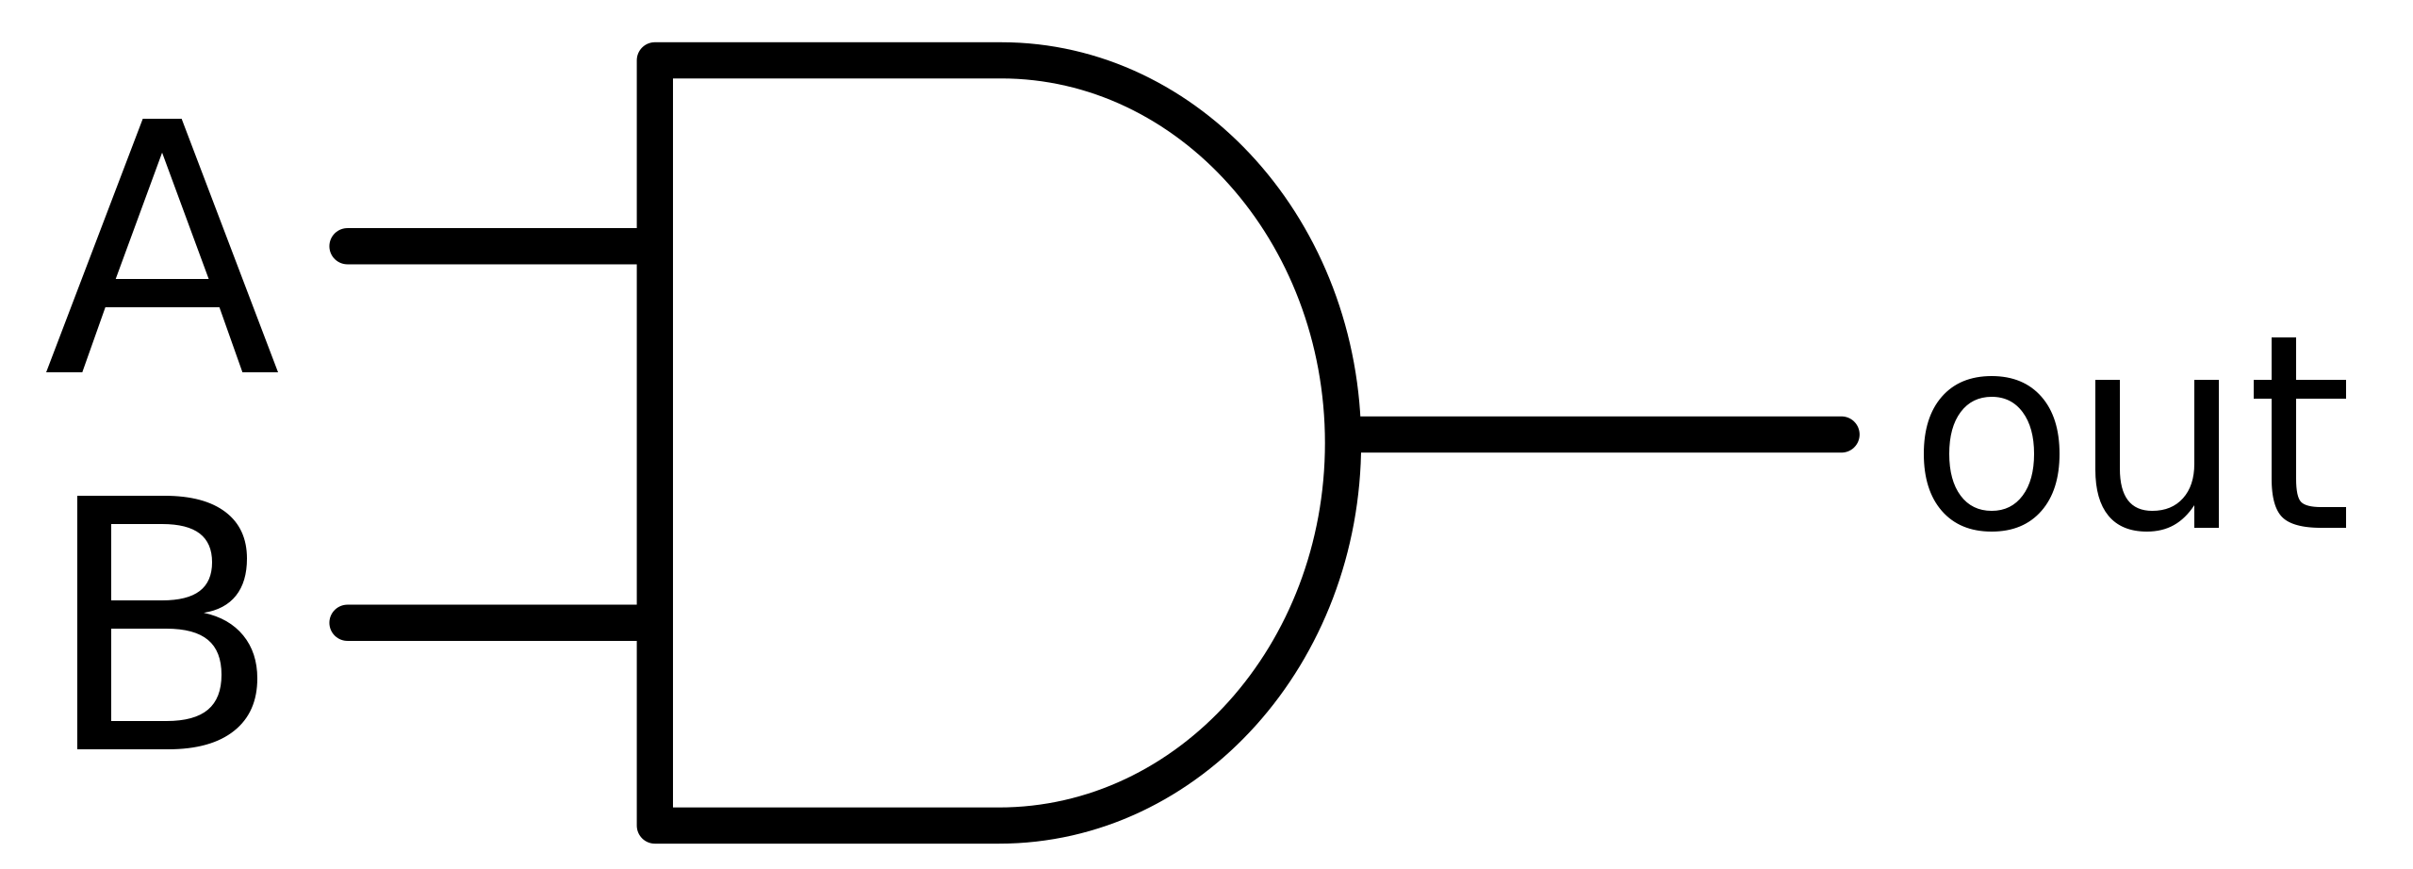
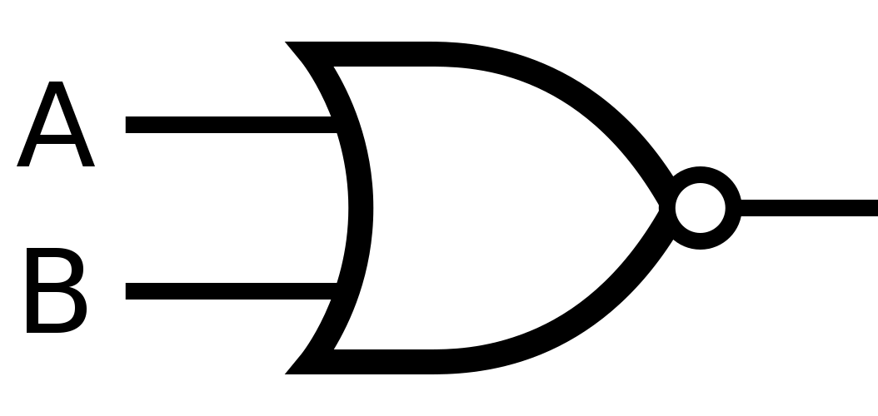
Ludwig Computing Proprietary and Confidential
501- Logic Gate
Figure 5
Possible Embodiment 1
Possible Embodiment 2
out

Slide 18
Ludwig Computing Proprietary and Confidential
Figure 5: Detailed Description of Logic Gate Configurations –
AND Gate and NOR Gate
Logic Gate Configurations:
Figure 5 illustrates two possible configurations for logic gates used in the neural network processing system’s bitwise multiplication block (Figures 4a and 4b) : an AND gate (left) and a NOR gate (right). These gates play a critical role in the system’s ability to perform logical operations on input activations and parameters, ensuring efficient and accurate processing.
Components:
1. AND Gate (Left Configuration):
• Performs a logical AND operation on the input signals.
• Outputs a high signal only if all input signals are high.
• Used to combine input activations and parameters in a straightforward manner.
2. NOR Gate (Right Configuration):
• Performs a logical NOR operation on the input signals.
• Outputs a high signal only if all input signals are low.
• If a NOR gate is used, inverted logic will be employed in the subsequent processing stages to ensure the correct interpretation of the results.
Functionality:
• AND Gate:
• Combines input signals based on logical AND rules.
• NOR Gate:
• Combines input signals based on logical NOR rules.
• When using the NOR gate, the outputs are interpreted with inverted logic so proper instructions will be employed to maintain consistency in the neural network’s processing flow.

Slide 19
Ludwig Computing Proprietary and Confidential
Figure 5: Detailed Description of Logic Gate Configurations – AND Gate and NOR Gate Continued…
Workflow:
• AND Gate Configuration:
• Receives input activations (ai) and parameters (wij) from their respective P-BLOCKs.
• Performs a logical AND operation, resulting in outputs that reflect the conjunction of the input signals.
• Outputs are forwarded to the addition block or other subsequent stages for further processing.
• NOR Gate Configuration:
• Receives input activations (ai) and parameters (wij) from their respective P-BLOCKs.
• Performs a logical NOR operation, resulting in outputs that reflect the disjunction of the input signals in an inverted manner.
• Outputs are interpreted using inverted logic to ensure correct processing in the neural network.
• These interpreted outputs are then forwarded to the addition block or other subsequent stages for further processing.

Slide 20
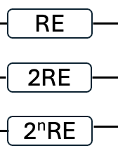
Ludwig Computing Proprietary and Confidential
600- Addition Block
Figure 6
1
2
…
n
601
5
6
…
V_{OUT}
…
…
602

Slide 21
Ludwig Computing Proprietary and Confidential
Figure 6: Detailed Description of Addition Block
Addition Block:
The Addition Block is a vital component in the neural network processing system, responsible for aggregating the results from the bitwise multiplication stage. This block combines the outputs from the multiplication block to produce the final processed data, which serves as the activation for the next layer of the neural network.
Components:
1. RE (Resistor Elements) 601:
• Represent the resistor elements used in the addition process.
• Provide precise resistance values to control the flow of current and ensure accurate addition of signals.
• Different magnitudes of resistor elements (1 x RE, 2 x RE, .., 2^{n} x RE) are used to represent different levels of bit significance. This ensures that each bit’s contribution to the final sum is weighted appropriately according to its significance in the binary representation.
Potential Embodiments:
• Active Resistor: Can be implemented using transistors with different widths that represent different levels of bit significance.
• Diffused Resistor: Created by doping a specific region of the semiconductor substrate.
• Polysilicon Resistor: Made from a layer of polysilicon deposited on the substrate.
• Thin-Film Resistor: Created by depositing a thin film of resistive material on the chip surface.
• Well Resistor: Implemented using the well regions in a CMOS process.
• Metal Resistor: Created using a metal layer to form the resistive path.
according to its significance in the binary representation.

Slide 22
Ludwig Computing Proprietary and Confidential
Figure 6: Detailed Description of Addition Block continued…
2. Addition Unit 602:
• Combines the outputs from the bitwise multiplication block using methods like adder trees or capacitor-based addition.
• Aggregates the input signals to produce the final output voltage (VOUT).
3. Input Signals (1 through n):
• Received from the previous bitwise multiplication block.
• Represent the intermediate results that need to be combined in the addition block.
4. Output Voltage (VOUT):
• The final aggregated result of the addition process.
• Serves as the activation for the next neural network layer, continuing the data processing pipeline.
Workflow:
• The Addition Block receives input signals (1 through n) from the bitwise multiplication block.
• These signals are processed through resistor elements (RE), which provide controlled resistance to accurately combine the signals.
• The addition unit (602) aggregates the input signals using precise methods, such as adder trees or capacitor-based addition, to ensure accurate summation.
• The resultant output voltage (VOUT) is produced, representing the final combined signal.
• This output voltage (VOUT) is then used as the activation for the next layer of the neural network, ensuring smooth and accurate data processing.

Slide 23
Ludwig Computing Proprietary and Confidential
Figure 6: Detailed Description of Addition Block continued…
Functionality:
• Resistor Elements (RE):
• Ensure precise control over the signal combination process by providing specific resistance values.
• Enable accurate and efficient aggregation of multiple input signals.
• Addition Unit:
• Utilizes advanced methods like adder trees or capacitor-based addition to combine the input signals.
• Ensures that the final output voltage (VOUT) accurately reflects the combined input signals.

Slide 24
Ludwig Computing Proprietary and Confidential
700- OUTPUTS
Figure 7
Possible Embodiment 1
V_{op}
V_{OUT}
OUTPUTS
6
701
Possible Embodiment 2
ADC
OUTPUTS
702

Slide 25
Ludwig Computing Proprietary and Confidential
Figure 7: Detailed Description of Outputs Block
Outputs Block:
The Outputs Block is a crucial component in the neural network processing system, responsible for producing the final processed data, which serves as the activations for the next layer of the neural network. This block ensures that the processed data is accurately converted and made ready for subsequent neural network layers or final output.
Components:
1. ADC (Analog-to-Digital Converter) 702:
• Converts the analog output signals into digital form.
• Ensures precise and accurate representation of the final processed data.
2. VOUT (Output Voltage) 701:
• Represents the final aggregated result from the addition block.
• This voltage serves as the input for the ADC to produce digital outputs.
3. Possible Embodiments:
• Embodiment 1 (p-bit):
• Utilizes a probabilistic bit (p-bit) technology to generate outputs.
• The p-bit incorporates probabilistic behavior, enhancing the neural network’s ability to handle uncertainty and variability in data.
• Embodiment 2:
• Uses traditional deterministic methods to generate outputs.
• Ensures reliable and predictable output behavior suitable for various applications.

Slide 26
Ludwig Computing Proprietary and Confidential
Figure 7: Detailed Description of Outputs Block – Continued…
Workflow:
• The Outputs Block receives the output voltage (VOUT) from the addition block.
• In Embodiment 1, the VOUT is processed through the p-bit technology, which introduces probabilistic elements into the output. This enhances the neural network’s capability to manage uncertainty and variability.
• In Embodiment 2, the VOUT is directly converted by the ADC without additional probabilistic processing, ensuring a deterministic output.
• The ADC (702) converts the analog VOUT into a digital signal, ensuring that the final processed data is accurately represented in digital form.
• The digital outputs from the ADC are then forwarded to the next layer of the neural network or used as the final output, depending on the system’s configuration.
Functionality:
• ADC (Analog-to-Digital Converter):
• Provides accurate conversion of analog signals into digital form.
• Ensures that the final processed data is suitable for digital processing in subsequent neural network layers.
• VOUT (Output Voltage):
• Acts as the key signal that carries the processed data from the addition block to the outputs block.
• Ensures smooth and accurate data transition within the neural network.

Slide 27
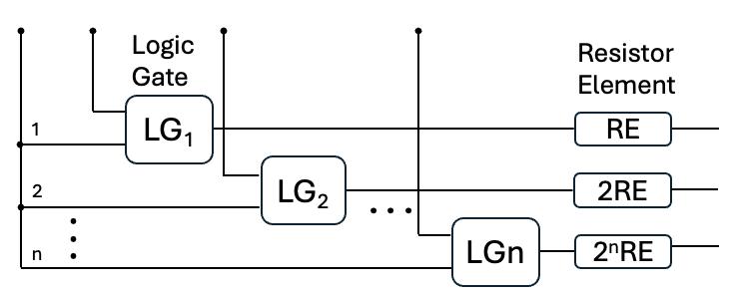
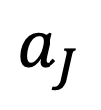
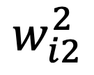

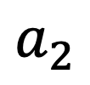



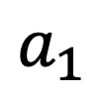
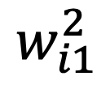



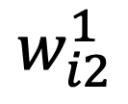

Ludwig Computing Proprietary and Confidential
Figure 8a
Memory
2
Act
ivat
ions
$$a_{1}$$
$$w_{i1}^{1}$$
$$w_{i1}^{2}$$
$$w_{i1}^{n}$$
$$a_{2}$$
$$w_{i2}^{1}$$
$$w_{i2}^{2}$$
$$w_{i2}^{n}$$
6
$$a_{J}$$
$$w_{iJ}^{1}$$
$$w_{iJ}^{2}$$
$$w_{iJ}^{n}$$
4
$$y_{i}=\sum_{jk}{w_{ij}^{k}a_{j}}$$
$$k:\text{runs} \text{over}$$
$$\text{digital} \text{bits} \text{of} w_{ij}$$

Slide 28
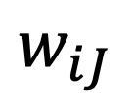
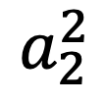
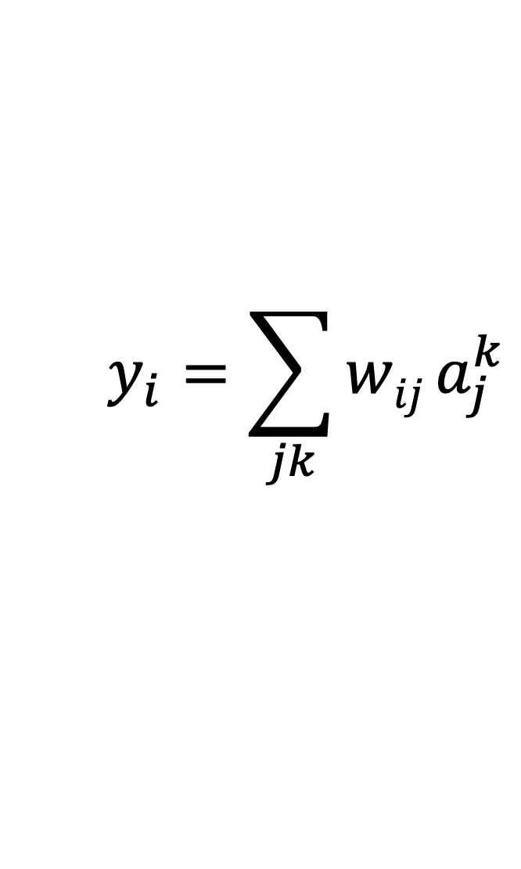










Ludwig Computing Proprietary and Confidential
Figure 8b
Activations
4
Memory
$$w_{i1}$$
$$a_{1}^{1}$$
$$a_{1}^{2}$$
$$a_{1}^{n}$$
$$w_{i}2$$
$$a_{2}^{1}$$
$$a_{2}^{2}$$
$$a_{2}^{n}$$
6
$$w_{iJ}$$
$$a_{J}^{1}$$
$$a_{J}^{2}$$
$$a_{J}^{n}$$
2
$$y_{i}=\sum_{jk}{wij}a_{j}^{k}$$
$$k:\text{runs} \text{over}$$
$$\text{digital} \text{bits} \text{of} \text{aj}$$

Slide 29
Ludwig Computing Proprietary and Confidential
Figures 8a and 8b: Illustrations of Neural Network Processing System Configurations
Overview:
Figures 8a and 8b illustrate different configurations of how various modules within the neural network processing system can be put together. These diagrams provide a holistic view of how inputs are processed through different probabilistic and deterministic components to generate the final outputs.
Components:
1. Memory:
• Stores parameters (weights and biases) and input activations required for computation.
2. Activations:
• The initial input activations that feed into the processing system.
3. Parameter P-BLOCK:
• Adds probabilistic elements to the parameters (weights and biases) retrieved from memory.
4. Neuron P-BLOCK:
• Introduces probabilistic elements into the input activations.
5. Bitwise Multiplication Block:
• Performs bitwise multiplication operations between the processed input activations and parameters.
6. Addition Block:
• Aggregates the results from the bitwise multiplication stage to produce a final combined signal.
7. Outputs Block:
• Converts the final aggregated signal into a form suitable for subsequent layers or final output.

Slide 30
Ludwig Computing Proprietary and Confidential
Figure 8a: Configuration Using P-Blocks for Activations Only
• This figure illustrates the system configuration where P-Blocks are applied to the activations (neurons) only. The weights are passed directly in their binary form bit by bit to the bitwise multiplication block.
• Workflow:
1. Memory provides initial parameters (weights) and activations.
2. Activations are processed through the Neuron P-BLOCK, introducing probabilistic variations to the activations.
3. Weights are passed directly in their binary form bit by bit to the Bitwise Multiplication Block.
4. Bitwise Multiplication Block performs bitwise multiplications between probabilistically varied activations and binary weights.
5. Addition Block aggregates the results of the bitwise multiplication.
6. Outputs Block converts the aggregated signal to the final output.
• Node Configuration:
• Each activation value is represented by one node shared between all the logic gates whose other inputs represent the bits of one weight value.

Slide 31
Ludwig Computing Proprietary and Confidential
Figure 8b: Configuration Using P-Blocks for Weights Only
• This figure illustrates the system configuration where P-Blocks are applied to the weights only. The activations are passed directly in their binary form bit by bit to the bitwise multiplication block.
• Workflow:
1. Memory provides initial parameters (weights) and activations.
2. Weights are processed through the Parameter P-BLOCK, introducing probabilistic variations to the weights.
3. Activations are passed directly in their binary form bit by bit to the Bitwise Multiplication Block.
4. Bitwise Multiplication Block performs bitwise multiplications between binary activations and probabilistically varied weights.
5. Addition Block aggregates the results of the bitwise multiplication.
6. Outputs Block converts the aggregated signal to the final output.
• Node Configuration:
• Each weight value is represented by one node shared between all the logic gates whose other inputs represent the bits of one activation value.
Importance:
• Figure 8a demonstrates a configuration where the neural activations are processed for probabilistic variations before being multiplied with binary weights.
• Figure 8b shows an alternative configuration where the weights are processed for probabilistic variations before being multiplied with binary activations.

Slide 32

Figure 9
Ludwig Computing Proprietary and Confidential
Recurrent Mode

Slide 33
Ludwig Computing Proprietary and Confidential
Figure 9: Recurrent Configuration with P-bit Activation Feedback
Overview:
Figure 9 illustrates an advanced configuration of the neural network processing system that introduces a recurrent mode. This configuration feeds the outputs back through a P-bit activation to the inputs of other blocks, enabling iterative processing and enhancing the system’s capability to handle complex data dependencies.
Components:
1. Memory:
• Stores parameters (weights and biases) and input activations required for computation.
2. Activations:
• The initial input activations that feed into the processing system.
3. Parameter P-BLOCK:
• Adds probabilistic elements to the parameters (weights and biases) retrieved from memory.
4. Neuron P-BLOCK:
• Introduces probabilistic elements into the input activations.
5. Bitwise Multiplication Block:
• Performs bitwise multiplication operations between the processed input activations and parameters.
6. Addition Block:
• Aggregates the results from the bitwise multiplication stage to produce a final combined signal.
7. Outputs Block:
• Converts the final aggregated signal into a form suitable for subsequent layers or final output.

Slide 34
Ludwig Computing Proprietary and Confidential
Figure 9: Recurrent Configuration with P-bit Activation Feedback continued…
Workflow:
1. Memory provides initial parameters (weights) and activations.
2. Activations are processed through the Neuron P-BLOCK, introducing probabilistic variations to the activations.
3. Weights are processed through the Parameter P-BLOCK, introducing probabilistic variations to the weights.
4. Bitwise Multiplication Block performs bitwise multiplications between probabilistically varied activations and weights.
5. Addition Block aggregates the results of the bitwise multiplication.
6. Outputs Block converts the aggregated signal to the final output.
7. Recurrent Feedback: The outputs are fed back through a P-bit activation to the inputs of other blocks, enabling recurrent processing and iterative enhancements.
Importance:
• The use of P-blocks for recurrent feedback through P-bit activation allows for enhanced adaptability and robustness in handling uncertainty and variability in data.
• The recurrent feedback mechanism facilitates iterative improvements and the ability to handle complex data dependencies, making the system suitable for tasks requiring sequential data processing and temporal dependencies.

Slide 35
The END

